Slide 1

COMM223 Marketing Management
Lecture 12 - Global Marketing and Marketing/Society

Slide 2
Agenda
Global market place
Sustainable marketing

Slide 3
Global Marketing in the 21st Century
International trade is booming
Global firm
Operates in more than one country
Gains research and development, production, marketing, and financial advantages that are not available to purely domestic competitors
Faces increasing problems
Highly unstable governments and currencies
Restrictive government policies and regulations
High trade barriers and corruption
国际贸易蓬勃发展
全球公司
在多个国家/地区开展业务
获得纯国内竞争对手无法获得的研发、生产、营销和财务优势
面临越来越多的问题
高度不稳定的政府和货币
限制性政府政策和法规
高贸易壁垒和腐败

Slide 4
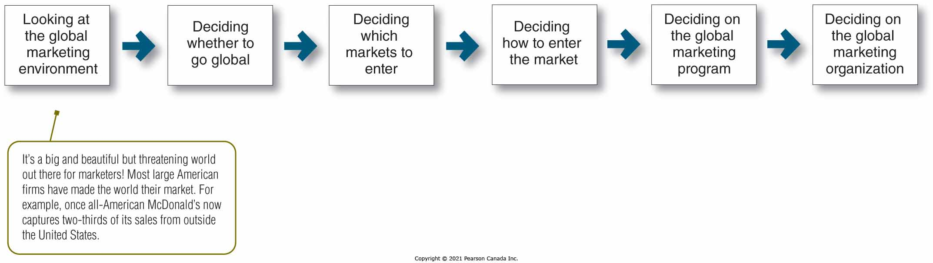
Major Decisions in International Marketing
A company faces six major decisions in international marketing
公司面临国际营销六大决策

Slide 5
Looking at the Global Marketing Environment
The International Trade System
Tariffs/duties, quotas, exchange controls, nontariff trade barriers
World Trade Organization and GATT
Regional economic communities or free trade zones
EU - European Union
NAFTA - North American Free Trade Agreement
国际贸易体系
关税/关税、配额、外汇管制、非关税贸易壁垒
世界贸易组织和关贸总协定
区域经济共同体或自由贸易区
欧盟 - 欧盟
NAFTA - 北美自由贸易协定

Slide 6
Looking at the Global Marketing Environment
Economic Environment
Industrial structure
Subsistence economies
Raw material exporting economies
Emerging economies
Industrial economies
Income distribution
Low-, medium-, and high-income households depending on the industrial structure of the nation
经济环境
产业结构
自给经济
原材料出口经济体
新兴经济体
工业经济、
收入分配
取决于国家产业结构的低、中、高收入家庭

Slide 7
Looking at the Global Marketing Environment
Political-Legal Environment
Considerations for a company to do business in a country:
Country’s attitude toward international buying
Government bureaucracy
Political stability
Monetary regulations
International trade involves
Cash transactions
Bartering
政法环境
公司在一个国家开展业务的注意事项：
国家对国际采购的态度
政府官僚机构
政治稳定
货币法规
国际贸易涉及
现金交易
以物易物

Slide 8
Looking at the Global Marketing Environment
Cultural Environment
Impact of Culture on Marketing Strategy
Cultural traditions, preferences, business norms and behavior vary from country to country.
Impact of Marketing Strategy on Cultures
Exposure to foreign products and media cause changes in values
文化环境
文化对营销策略的影响
文化传统、偏好、商业规范和行为因国家而异。
营销策略对文化的影响
接触外国产品和媒体导致价值观的变化

Slide 9
Deciding Whether to Go International
Not all companies need to venture into international markets
The domestic marketplace is easier and safer
However, companies need to monitor international businesses
Several factors may drawn a firm into the international arena
Attacks on a company’s home market by global competitors
Expanding customer base in international markets
Better opportunities for growth
The company needs to evaluate its abilities and the consumer and business environments in other countries
并非所有公司都需要冒险进入国际市场
国内市场更容易、更安全
但是，公司需要监控国际业务
几个因素可能会吸引一家公司进入国际舞台
全球竞争对手对公司本土市场的攻击
在国际市场扩大客户群
更好的增长机会
公司需要评估其能力以及其他国家的消费者和商业环境

Slide 10
Deciding Which Markets to Enter
A company should
Define its international marketing objectives and policies
Decide what volume of foreign sales it wants
Choose in how many countries it wants to market
Determine the types of countries to enter
Evaluate each market
一个公司应该
定义其国际营销目标和政策
决定它想要多少国外销售量
选择要在多少个国家进行营销
确定要进入的国家类型
评估每个市场

Slide 11
Indicators of Market Potential
Demographic Characteristics | Sociocultural Factors
Education Population size and growth Population age composition | Consumer lifestyles, beliefs, and values Business norms and approaches Cultural and social norms Languages
Geographic Characteristics | Political and Legal Factors
Climate Country size Population density—urban, rural Transportation structure and market accessibility | National priorities Political stability and compatibility Government attitudes toward global trade Government bureaucracy Monetary and trade regulations
Economic Factors
GDP size and growth Income distribution Industrial infrastructure Natural resources Financial and human resources

Slide 12
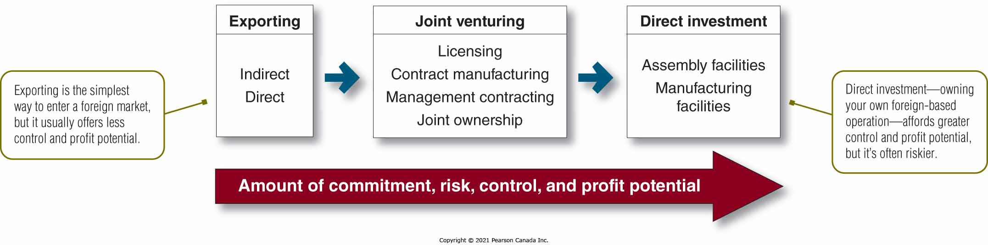
Deciding How to Enter the Market
The company must determine the best mode of entry.
Each subsequent entry strategy involves more commitment and risk, but also more control and potential profits.
公司必须确定最佳的进入方式。
随后的每个进入策略都涉及更多的承诺和风险，但也涉及更多的控制和潜在利润。

Slide 13
Deciding How to Enter the Market
Exporting
Direct vs. indirect
Joint Venturing
Licensing, contract manufacturing, management contracting, joint ownership
Direct Investment
Assembly facilities, manufacturing facilities
出口
直接与间接
合资企业
许可、合同制造、管理承包、共同所有权
直接投资
组装设施、制造设施

Slide 14
Deciding on the Global Marketing Program
Standardized global marketing
Using the same marketing strategy and mix in all of the company’s international markets
Adapted global marketing
Adjusting the marketing strategy and mix elements to each international target market
Creates more costs
Produces a larger market share and return
It’s not about all-or-nothing, but a matter of degree
Think globally, but act locally
Advocate a “global” strategy in which the firm standardizes certain core marketing elements and localizes others
标准化的全球营销
使用相同的营销策略并在公司的所有国际市场中进行组合
适应全球营销
针对每个国际目标市场调整营销策略和组合元素
产生更多成本
产生更大的市场份额和回报
这不是全有或全无，而是程度的问题
放眼全球，立足本土
倡导“全球”战略，在该战略中，公司将某些核心营销要素标准化，并将其他要素本地化

Slide 15
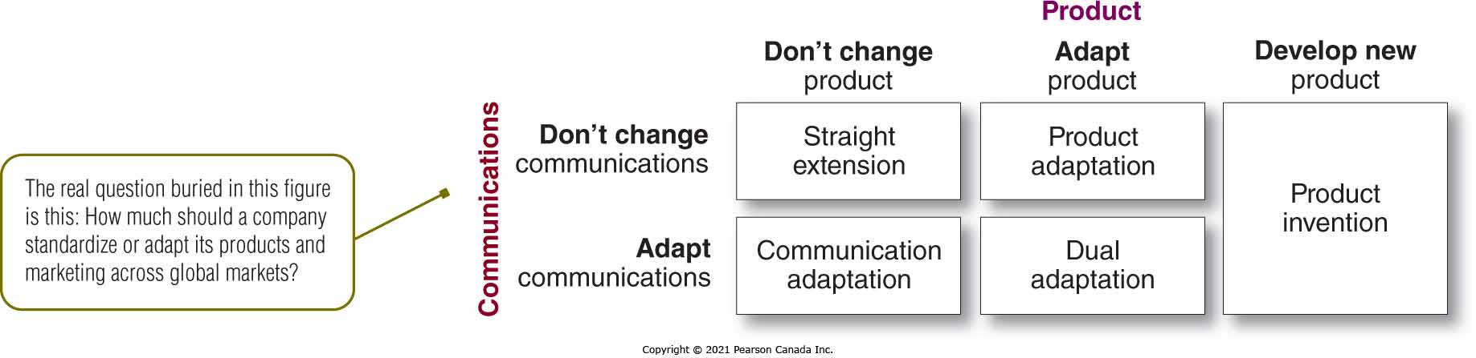
Deciding on the Global Marketing Program
Marketing Mix: Product and promotion
Five Global Product and Promotion Strategies
营销组合：产品和促销
五种全球产品及推广策略

Slide 16
Deciding on the Global Marketing Program
Marketing Mix: Pricing
Problems in setting prices include:
Charge a uniform price all around the world → Too high in poor countries and too low in rich countries.
Charge what consumers in each country could pay → ignores differences in the actual costs.
Use a standard markup of its costs everywhere → not effective in countries where costs are high.
International prices tend to be higher than domestic prices because of price escalation.
Cost of transportation, tariffs & importer, wholesaler, and retailer margins
The Internet forces companies toward more standardized international pricing
营销组合：定价
定价问题包括：
在全球范围内收取统一的价格→ 在贫穷国家太高，在富裕国家太低。
收取每个国家消费者可以支付的费用→ 忽略实际成本的差异。
在任何地方都使用标准的成本加成 → 在成本高的国家无效。
由于价格上涨，国际价格往往高于国内价格。
运输成本、关税和进口商、批发商和零售商利润
互联网迫使企业走向更标准化的国际定价

Slide 17
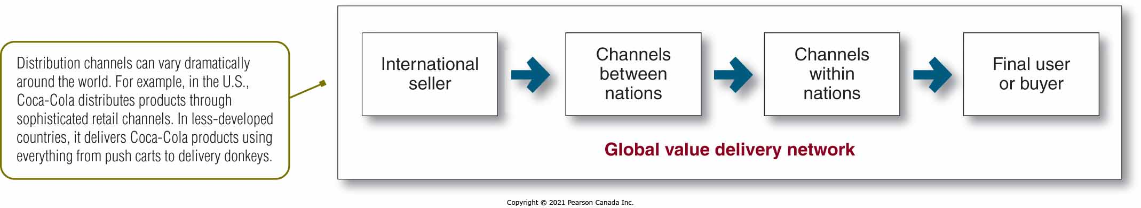
Deciding on the Global Marketing Program
Marketing mix: Distribution
Whole-channel view
Channels between nations
Channels within nations
营销组合：分销
全渠道视图
国家之间的渠道
国内渠道

Slide 18
Deciding on the Global Marketing Organization
Managing International Marketing Activities
Organizing an export department
Creating international divisions
Geographical organizations
World product groups
International subsidiaries
Becoming a global organization
管理国际营销活动
组建出口部门
创建国际部门
地理组织
世界产品组
国际子公司
成为全球性组织

Slide 19
Social Criticisms of Marketing
Marketing’s Impact on Individual Consumers
High Prices
High costs of distribution
High advertising and promotion costs
Excessive markups
Deceptive Practices
Pricing
Promotion
Packaging
High-Pressure Selling
Shoddy or unsafe products
Planned obsolescence
Poor service to disadvantaged consumers
营销对个人消费者的影响
高价
分销成本高
高昂的广告和促销成本
过度加价
欺骗行为
价钱
晋升
包装
高压销售
劣质或不安全的产品
计划报废
对弱势消费者的服务差

Slide 20
Social Criticisms of Marketing
Marketing’s Impact on Society as a Whole
False wants and too much materialism
Too few social goods
Cultural pollution
营销对整个社会的影响
虚假的欲望和过多的唯物主义
社会产品太少
文化污染

Slide 21
Social Criticisms of Marketing
Marketing’s Impact on Other Businesses
Acquisitions of competitors
Marketing practices which create barriers to entry
Unfair competitive marketing practices
营销对其他业务的影响
收购竞争对手
造成进入壁垒的营销实践
不公平的竞争营销行为

Slide 22
Traditional Rights
Seller’s rights | Buyer’s rights
To introduce any product in any size and style with proper warnings and controls, if necessary | To buy a product that is offered for sale
To charge any price for the product without any discrimination | To expect the product to be safe
To spend any amount to promote the product if competing fairly | To expect the product to perform as claimed
To use any product message that is not misleading or dishonest
To use buying incentive programs that are not unfair or misleading

Slide 23
Consumerism消费主义
To be well informed
To be protected against questionable products and marketing practices
To influence products and marketing practices to improve “quality of life”
To consume in a way to preserve the world for future generations of consumers
消息灵通
免受可疑产品和营销行为的侵害
影响产品和营销实践以提高“生活质量”
以一种为后代消费者保护世界的方式消费

Slide 24
Environmentalism 环保主义
Protects and improves people’s current and future living environment
Concerned with
Damage to the ecosystem
Loss of recreational areas
Increase in health problems
Environmental sustainability: Generating profits while helping protect the environment
保护和改善人们当前和未来的生活环境
关注于
对生态系统的破坏
休闲区的丧失
健康问题增加
环境可持续性：在帮助保护环境的同时创造利润

Slide 25
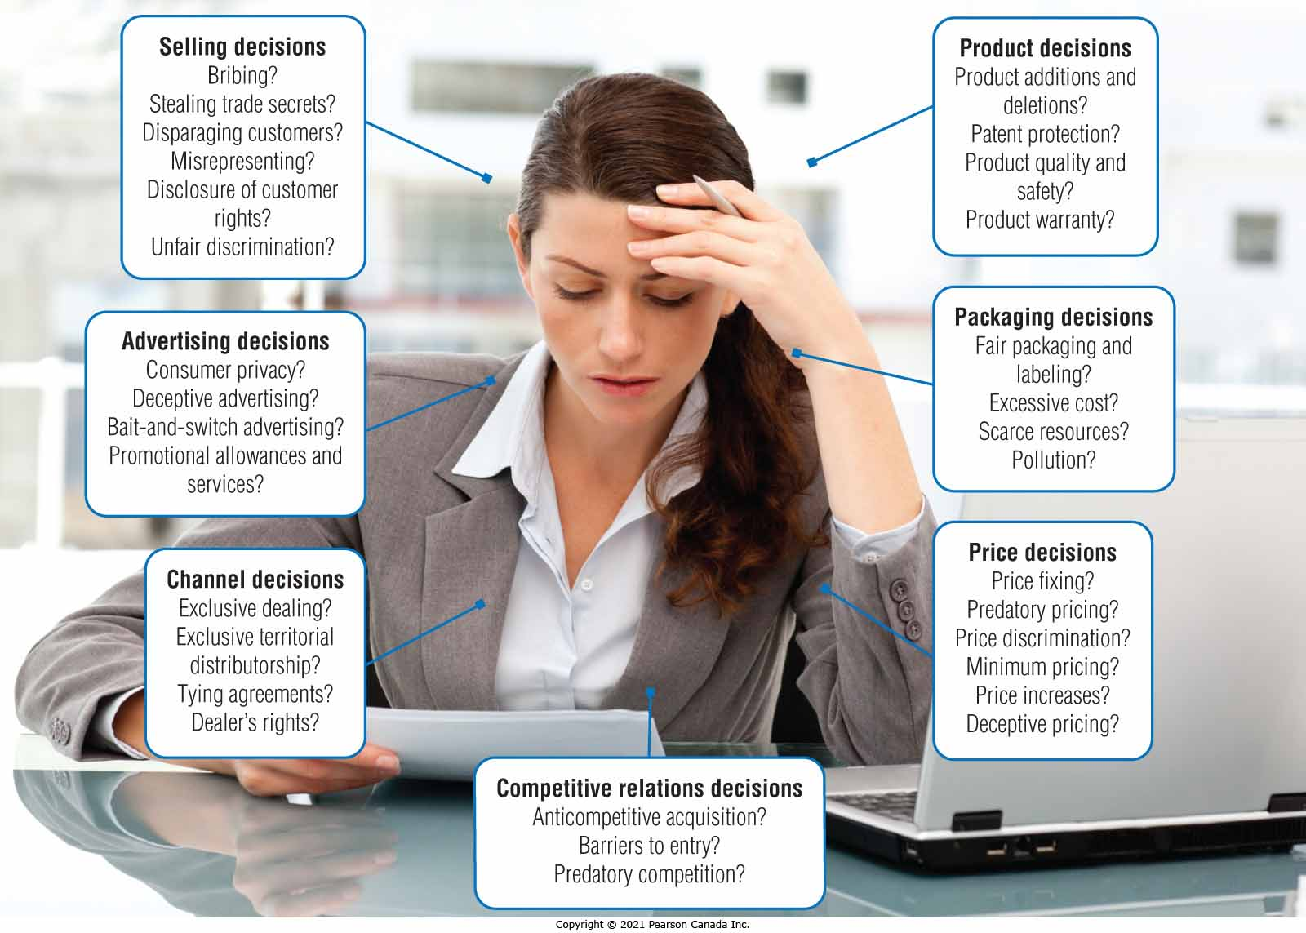
Major Marketing Decision Areas That May Be Called into Question under the Law

Slide 26
Sustainable Marketing Principles
Consumer-oriented marketing
Viewing and organizing a company’s marketing activities from the consumer’s point of view
Customer value marketing
Putting most of a company’s resources into customer value-building marketing investments
Innovative marketing
Seeking real product and marketing improvements
面向消费者的营销
从消费者的角度看待和组织公司的营销活动
客户价值营销
将公司的大部分资源用于建立客户价值的营销投资
创新营销
寻求真正的产品和营销改进

Slide 27
Sustainable Marketing Principles
Sense-of-mission marketing
Defining a company’s mission in broad social terms
Societal marketing
Making marketing decisions by considering
Consumers’ wants
Company’s requirements
Consumers’ long-run interests
Society’s long-run interests
使命感营销
用广义的社会术语定义公司的使命
社会营销
通过考虑做出营销决策
消费者的需求
公司要求
消费者的长期利益
社会的长远利益

Slide 28
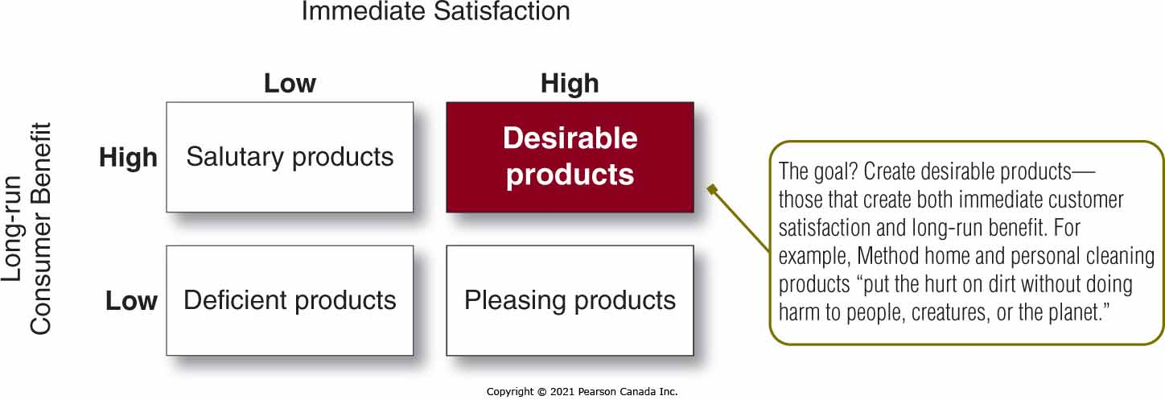
Societal Classification of Products

Slide 29
Marketing Ethics
Principles are needed to guide companies and marketing managers on issues of ethics and social responsibility.
The free market and the legal system should decide such issues.
Responsibility is in the hands of individual companies and managers.
Addressing ethics helps build strong customer relationships based on honesty and trust.
需要原则来指导公司和营销经理处理道德和社会责任问题。
自由市场和法律制度应该决定这些问题。
责任在个别公司和管理者手中。
解决道德问题有助于在诚实和信任的基础上建立牢固的客户关系。

Slide 30
The Sustainable Company
Sustainable companies create value for customers through socially, environmentally, and ethically responsible actions.
Sustainable marketing provides the context in which companies can build profitable customer relationships.
可持续发展的公司通过对社会、环境和道德负责的行动为客户创造价值。
可持续营销为公司建立有利可图的客户关系提供了环境。

Slide 31
A Framework for Marketing Management
Company
Company Analysis
Competitor Analysis
Consumer Analysis
Marketing Management
Competitor
Consumer
Product
Promotion
Price
Distribution
Product - Market

Slide 32
Thank you!
Good luck on the final!

